Slide 1

libROM tutorial: Poisson equation and its reduced order model
Youngsoo Choi
Notes:
Welcome everyone. Today, we will derive a projection-based reduced order model for the Poisson equation. It will be fun, so please stay tuned!

Slide 2
Poisson equation
Strong form
Million unknowns
Linear system of equations
for
h refinement
Million basis functions
Million elements
Notes:
In the previous tutorial, we started from a strong form of the Poisson equation and …/… derived a linear system of equations that comes from the finite element discretization. By the way, …/… do you remember that the solution of the finite element method was expressed as a linear combination of pre-defined basis functions, PHIs? Because of this solution representation, the characteristics of the solution is completely determined by the characteristics of the basis functions. …/…
For example, let’s say we have one dimensional solution space, represented by a real line from a to b and …/… it is discretized by several space-filling non-overlapping subsets, which we call each subset, an element. Let’s also assume that …/… the true solution function, u, is this smooth function, …/… which takes an input of real number between a and b and maps to a real number. …/… Now let’s define several basis functions, which also map a real number between a and b …/… Let’s assume that each basis function is locally supported on the domain and has a form of continuous piece-wise linear function. Because we have 9 elements in total, …/… assuming zero values at the two end points, …/… we …/… need …/… 8 …/… piece-wise …/… linear …/… basis …/… functions. …/… Now, the best way of approximating the solution function, u, by linearly combining these basis functions is …/… to match the nodal points on the curve …/… by …/… appropriately …/… scaling .../… each …/... basis …/… function …/… …/… which gives this purple piece-wise linear curve as a finite element approximate solution function. It looks pretty good, right? It is easy to see that if you increase the number of elements, the approximated solution converges to the true solution function. …/… By the way, this is known as h-refinement, where h stands for the size of the element. However, the h-refinement does not come for free. …/… For example, let’s say you introduce a million elements …/… then you need around a million basis functions …/… In turn, a million basis functions imply a million unknowns in the linear system of equations, which make the solution process computationally expensive.

Slide 3
locally supported
p refinement
for
Notes:
By the way, instead of increasing the number of elements, there is another way of improving the accuracy of the finite element approximation. To see that, note that each basis function does not need to be piece-wise linear function. …/… Instead, we can use quadratic, cubic, quartic, or even quintic functions, which are higher-order polynomials than linear functions. …/… As we increase the order of the polynomials in the basis functions, …/…we can easily imagine that we can arbitrarily improve the accuracy of the finite element solution without increasing the number of elements …/… This is called p-refinement, where p stands for the order of the basis functions. Although p refinement lets you improve the accuracy without increasing the number of elements, the accuracy does not come for free. …/… Do you remember that the weak form involves the integral of the basis functions. We compute the integral numerically by adding the weighted values at the quadrature points. The number of quadrature points needs to be increased as the order of the polynomials in the basis functions increases. This implies that the computational cost is increasing as the order, p, increases in p-refinement.
By the way, whether the basis functions are linear or higher order, …/… note that they take non-zero values only on the subset of the whole domain …/… we call these functions “locally supported.”

Slide 4
globally supported
One element
Notes:
Now let’s imagine something: An extreme case of the p-refinement. What if …/… our element is the whole domain itself …/… and our basis functions are defined over the whole domain. …/… Perhaps the first basis function looks like this …/… the second basis function looks like that. Because they take non-zero values over the whole domain, …/… we call these basis functions, globally supported. If the quality of these global basis functions is good, then we are hopeful that …/… this finite element solution representation will provide an accurate solution …/… for example, there are coefficients u_1 and u_2 such that the linear combination of phi_1 and phi_2 is equal or very close to the true solution function, u*.
This is exactly the concept followed by the reduced order model approach that I am going to introduce now. I will introduce a reduced order model by answering the following questions.

Slide 5
How do we get a set of globally supported basis functions?
Notes:
Now, then we have questions. How would we get a set of globally supported basis functions? To answer this question, …/… let’s go back the 1D example we have been looking at. …/… Now let’s assume that the first basis function is equal to the true solution, u*. I know that this does not make sense because you do not need to solve for u* if you already know what u* is. I know, I know, but let’s assum

Slide 6
Notes:
To explain the p refinement, note that

Slide 7
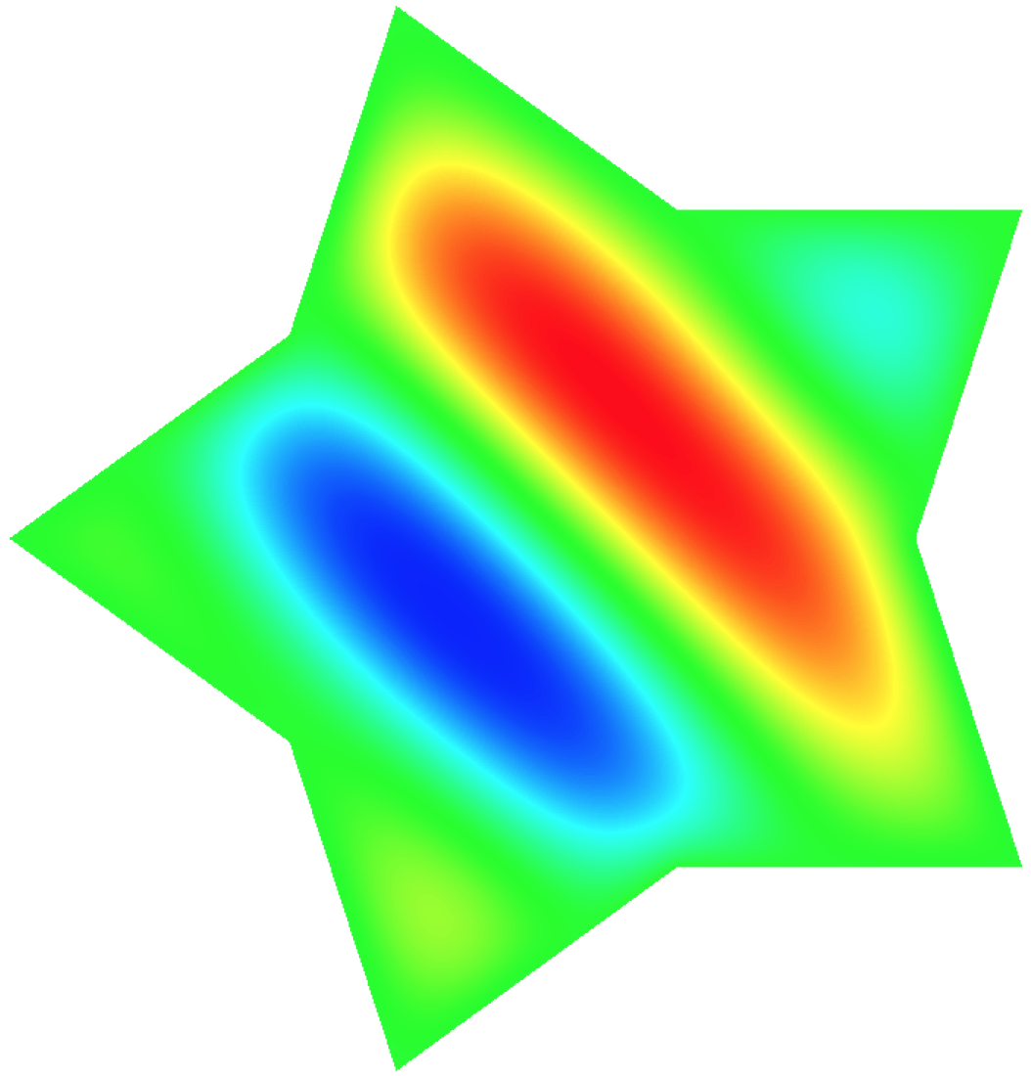
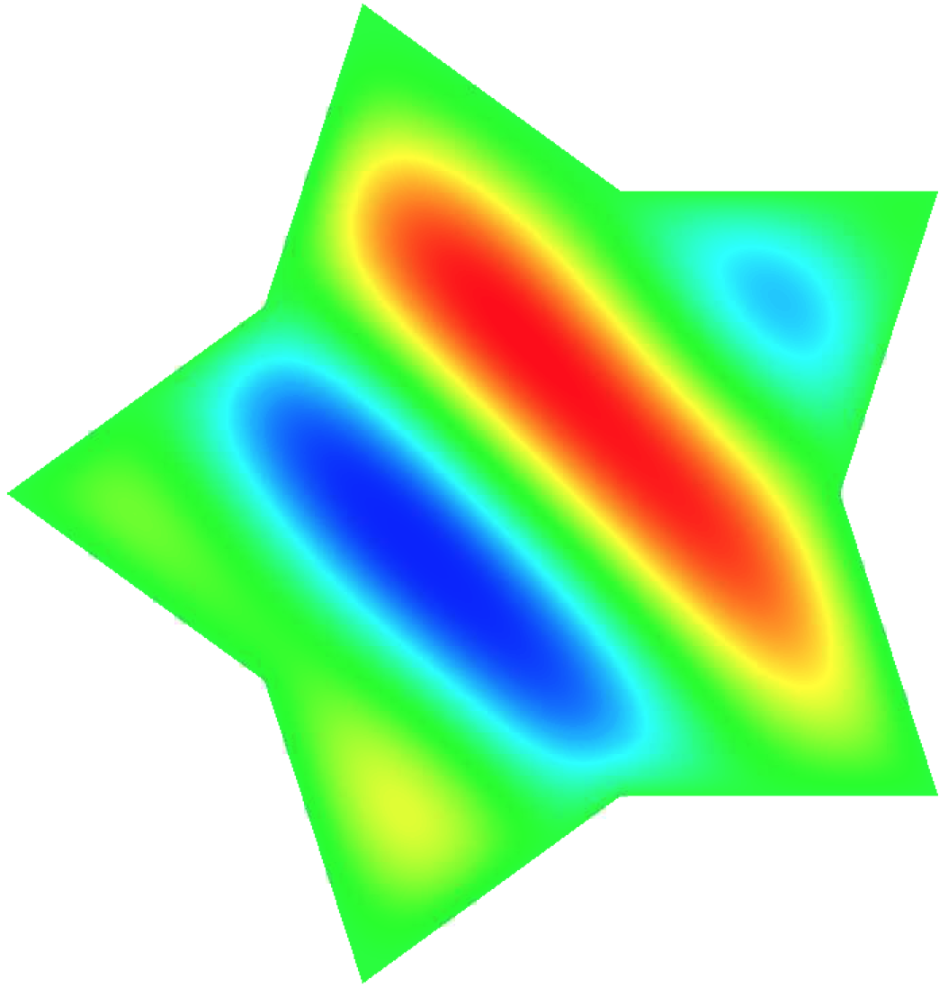
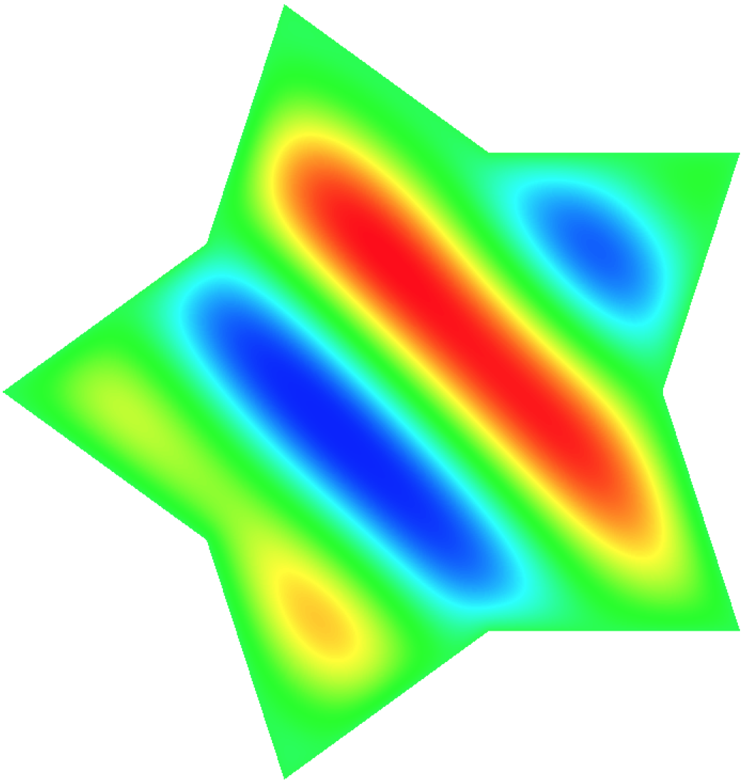
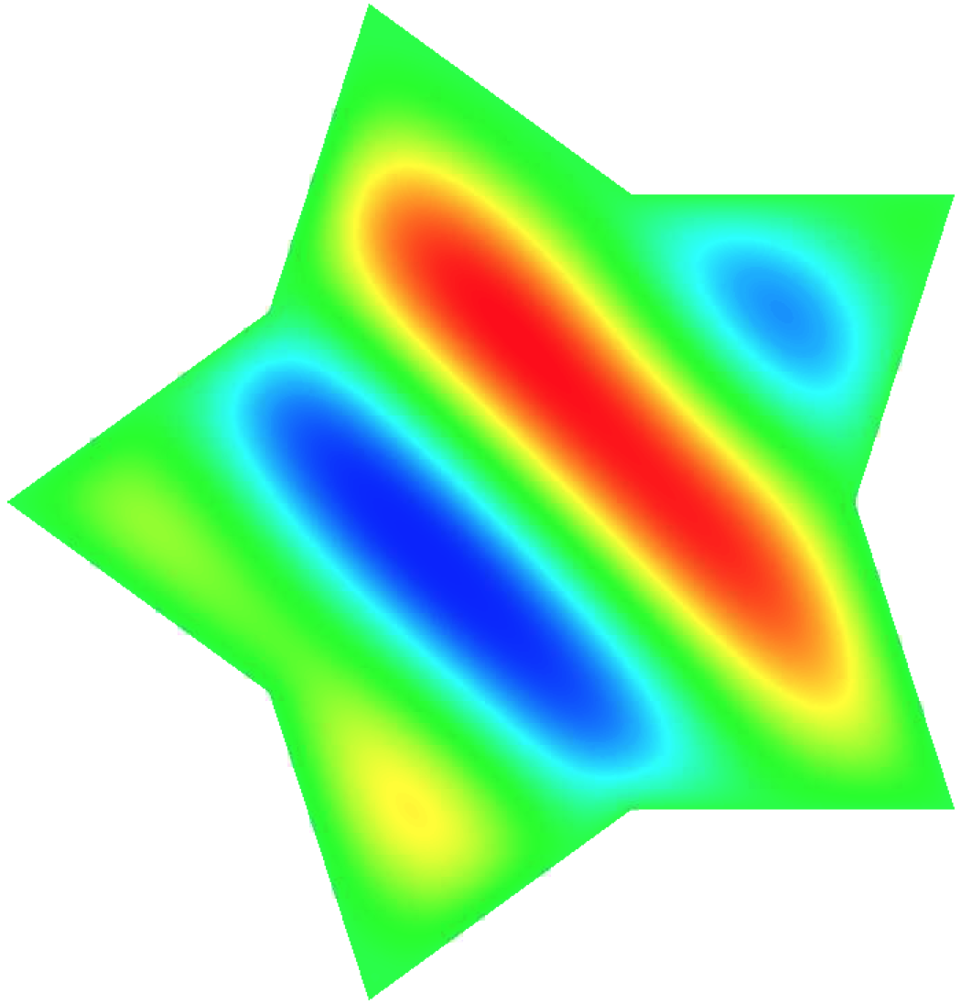


Slide 8
Disclaimer
This document was prepared as an account of work sponsored by an agency of the United States government. Neither the United States government nor Lawrence Livermore National Security, LLC, nor any of their employees makes any warranty, expressed or implied, or assumes any legal liability or responsibility for the accuracy, completeness, or usefulness of any information, apparatus, product, or process disclosed, or represents that its use would not infringe privately owned rights. Reference herein to any specific commercial product, process, or service by trade name, trademark, manufacturer, or otherwise does not necessarily constitute or imply its endorsement, recommendation, or favoring by the United States government or Lawrence Livermore National Security, LLC. The views and opinions of authors expressed herein do not necessarily state or reflect those of the United States government or Lawrence Livermore National Security, LLC, and shall not be used for advertising or product endorsement purposes.

